Slide 1

GEOG 4GA3 Applied Spatial Statistics
School of Geography and Earth Sciences
McMaster University
Antonio Páez

Slide 2
What is spatial statistics?

Slide 3
Applications of spatial statistics
Geosciences
Ecology
Economics
Business intelligence
Policy analysis
Transportation planning
Etc.

Slide 4
Applied spatial statistics @ Mac
Complement to GIS suite of courses
Follow up to GEOG 3MB3: Emphasis on spatial data and effects

Slide 5
Applied spatial statistics @ Mac
Instructors
Antonio Páez
Patrick De Luca
Style of course
Flipped classroom
Literate programming

Slide 6
What is a flipped classroom?

Slide 7

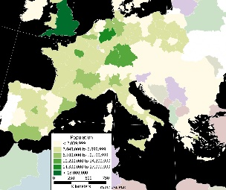
Traditional classroom
Yak, yak, yak,
yak,
yak,
yak…
Instructor is:
Performer
Entertainer
Sage
Granter of wisdom
Y = Xβ
WY

Slide 8
Traditional classroom
Class time is used by the instructor to deliver contents, typically in a lecture format
Instructor is responsible for delivering contents
Students read/cover materials outside of the classroom after each session (in the form of homework, assignments, etc.)
Students are responsible for understanding contents
Verification of compliance happens periodically, in the form of examinations/graded assignments

Slide 9
Flipped classroom
Today’s activity
X
Y
Readings
for next class
Instructor is:
Expert
Guide
Partner

Slide 10
Flipped classroom
Students read/cover materials outside of the classroom prior to each session
Students are responsible for understanding contents
Class time is used to engage with concepts in a collaborative way
Instructor is responsible for verifying compliance by solving issues, clarifying concepts, assisting with activities
Further verification of compliance in the form of examinations/graded assignments

Slide 11
Structure of a session
Initial 5-10 minutes will be used to discuss readings/practice, clarify concepts, etc.
To optimize the use of time, take notes when you are completing your readings/practice, bring specific questions to the classroom
Last 40-45 minutes will be used for an in-class activity
This may include discussion, problem-solving, or an exercise

Slide 12
Next session
Check Readings and Practice
These are your assigned contents for the following session
Check In-class Activity
This will be the activity for the class

Slide 13
What is a literate programming?

Slide 14
Traditional programming
Code forms the core of a program
Code is documented in natural language

Slide 15
Literate programming
Explanations of process in natural language form the core of a program
Code is used to support explanations

Slide 16
How will literate programming be implemented?

Slide 17
Literate programming
The R Project for Statistical Computing
An open source language for statistics and computing
Free
Convenient
Powerful
Has become a backbone of data science and thus is increasingly required by employers

Slide 18
Computers in classroom
Bring your personal computer to the classroom
Make sure that you have internet connectivity
No computer? No problem

Slide 19
Next session
Readings and Practice
Installing R and R Studio
Basic operations/data structures in R
Introduction to mapping in R
In-class Activity
Statistical maps

Slide 20
Suggested Readings
Flipped classrooms
https://en.wikipedia.org/wiki/Flipped_classroom
Literate programming
https://en.wikipedia.org/wiki/Literate_programming
The R Project for Statistical Computing
https://en.wikipedia.org/wiki/R_(programming_language)

Slide 21




THE GIS LABS: BSB 331 & 332

Slide 22

About the Lab & GIS @ Mac
One of 10 Centres of Excellence for GIS across Canada
Opportunities for student recognition (Awards, Scholarships)
Esri Canada Higher Education Scholarship in GIS
Esri Canada Young Scholar Award
App Challenge 2018 and other competitions
https://www.science.mcmaster.ca/geo/gis/esri-canada-centre-of-excellence.html
Networking opportunities at User Conferences
Internships
https://www.science.mcmaster.ca/geo/gis/internships.html

Slide 23

About the Lab & GIS @ Mac
Updated GIS Lab information can be found on the GIS Bulletin Board outside the labs
Up-to-date information about the Labs
GIS in the News
Program information
Employment Opportunities (including internships)

Slide 24
About the Lab
Current Hardware Environment
Windows 2012 R2 Server
50 Windows 7 x64 Clients
Primary Software used this term
ArcGIS Pro 2.x
R and R Studio
GeoDa

Slide 25
Lab Software and Ownership Policies
Academic Site License for ArcGIS
You retain rights to your original work, but once course is done you have no rights to access the software in the GIS Lab, you must obtain additional permissions, or you can use the Map Library, OR
Can purchase a student version of ArcGIS for $30 (good for 1 year from activation date)
If interested, please download form from Avenue, fill it out and bring to Pat in BSB 342

Slide 26

Lab Policies (1)

Slide 27
Lab Policies (2)
FOR ACADEMIC USE ONLY!
Primarily for: 3GI3, 3SR3, 4GA3, GEO 714
User Accounts are your own, please don’t share them
Disk Storage is not provided, please use a USB drive
Please be aware that PCs in the labs will be re-formatted at least once a month but may be more often depending on security or performance software patches

Slide 28
Lab Policies (3)
Reporting bugs with software/hardware
Please email any issues to Patrick DeLuca
delucapf@mcmaster.ca
Student access is available as long as the building is open.
Login ID/Password
Change password immediately upon first logon
Room maintenance
Please keep the lab clean, remember you are on camera!

Slide 29
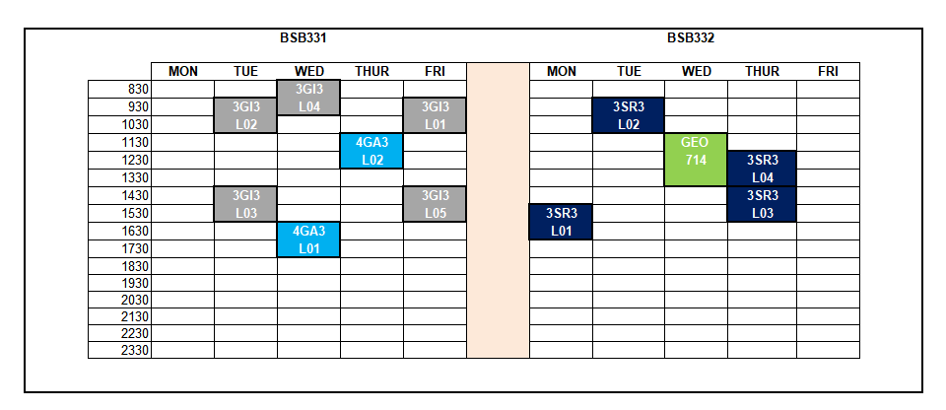
Lab Schedule

Slide 30
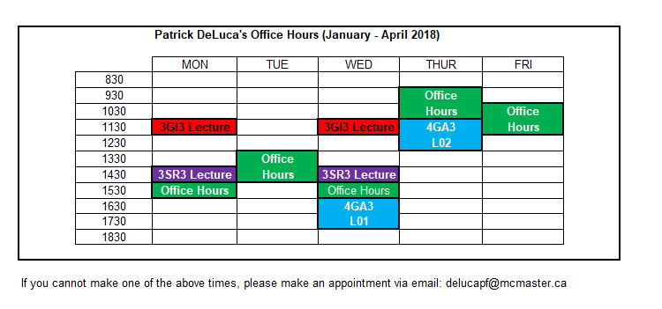
Pat’s Office Hours

